Slide 1

Animal Services Advisory Board, Director’s Report
FY 25, Quarter 3

Slide 2
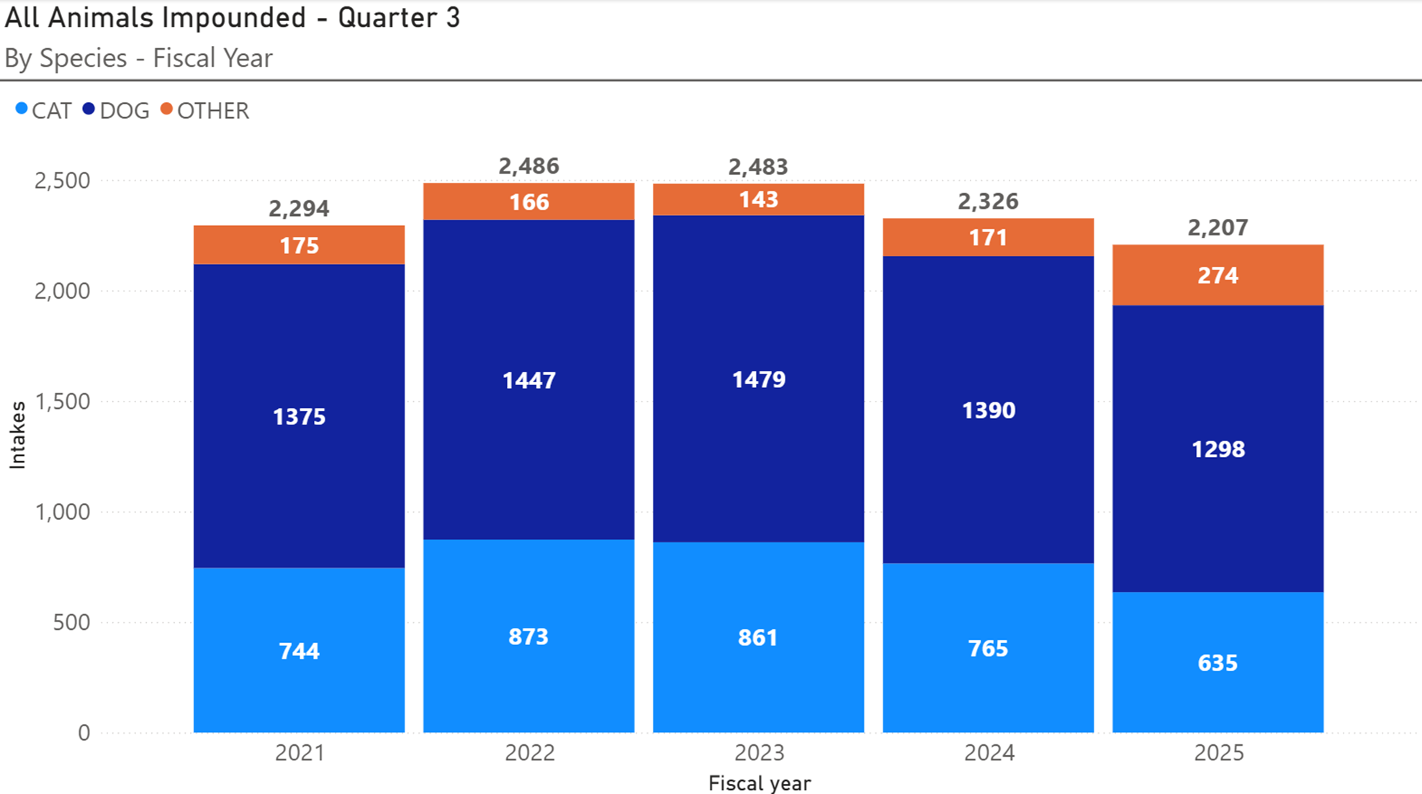
Animal Intake

Slide 3
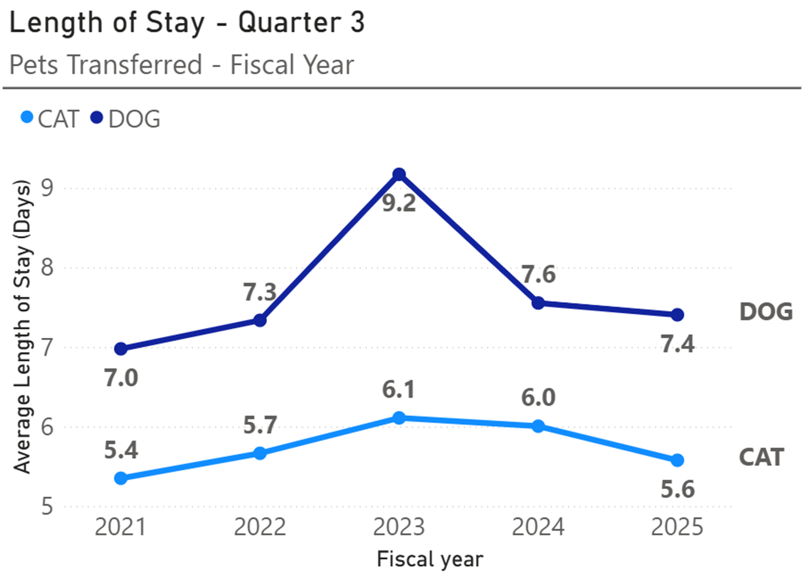
Length of Stay

Slide 4
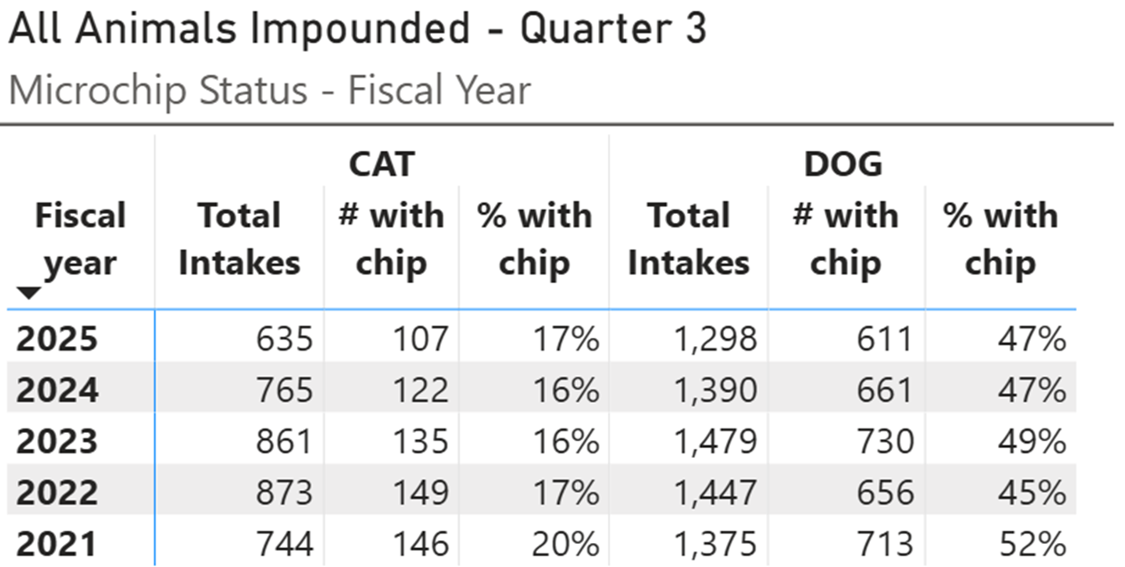
Intake - Microchip stat
Animals Impounded with Microchips

Slide 5
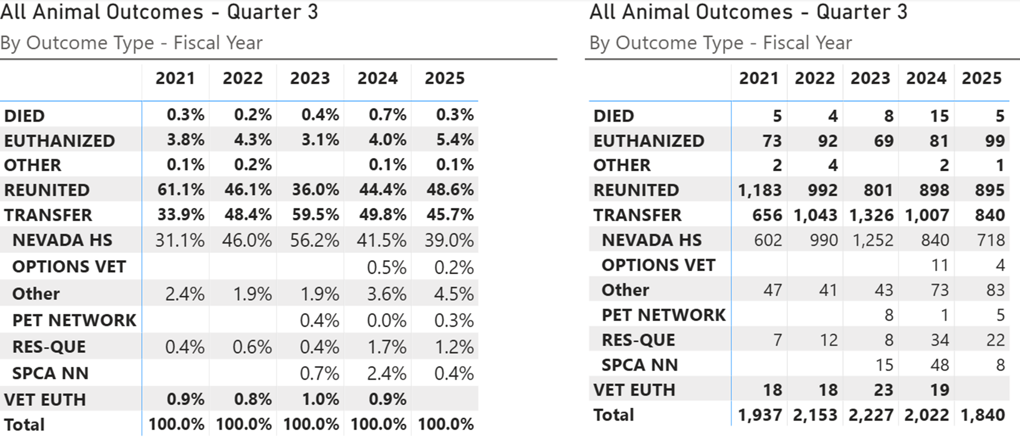
All Outcomes

Slide 6
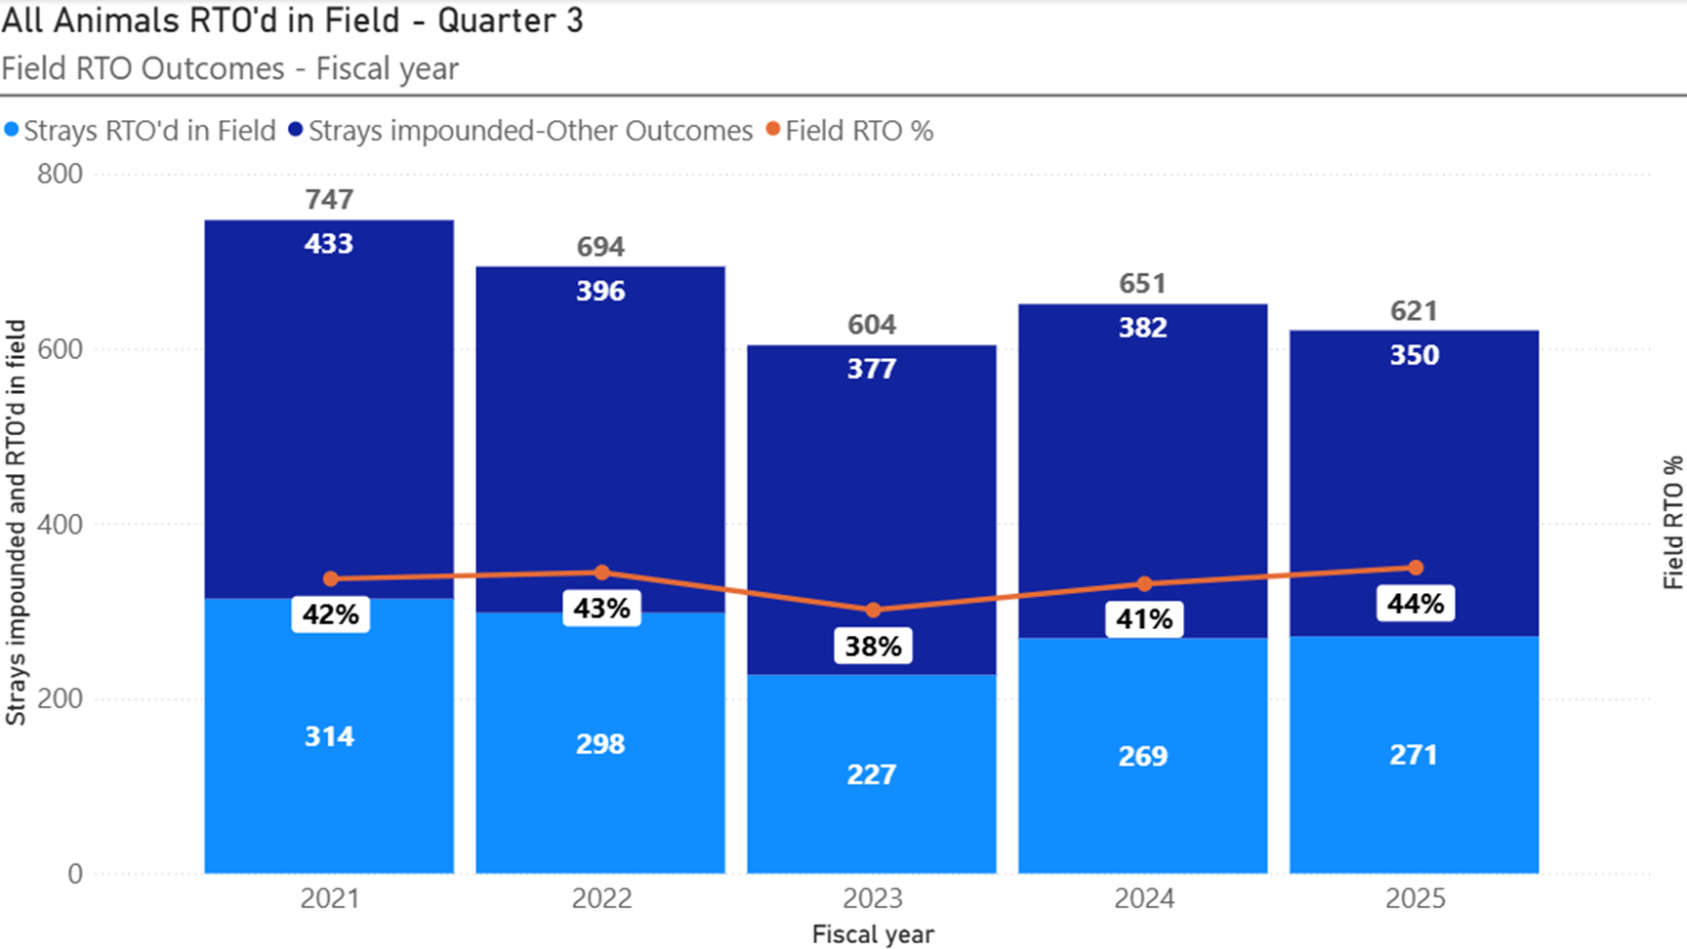
Animals Reunited in Field

Slide 7
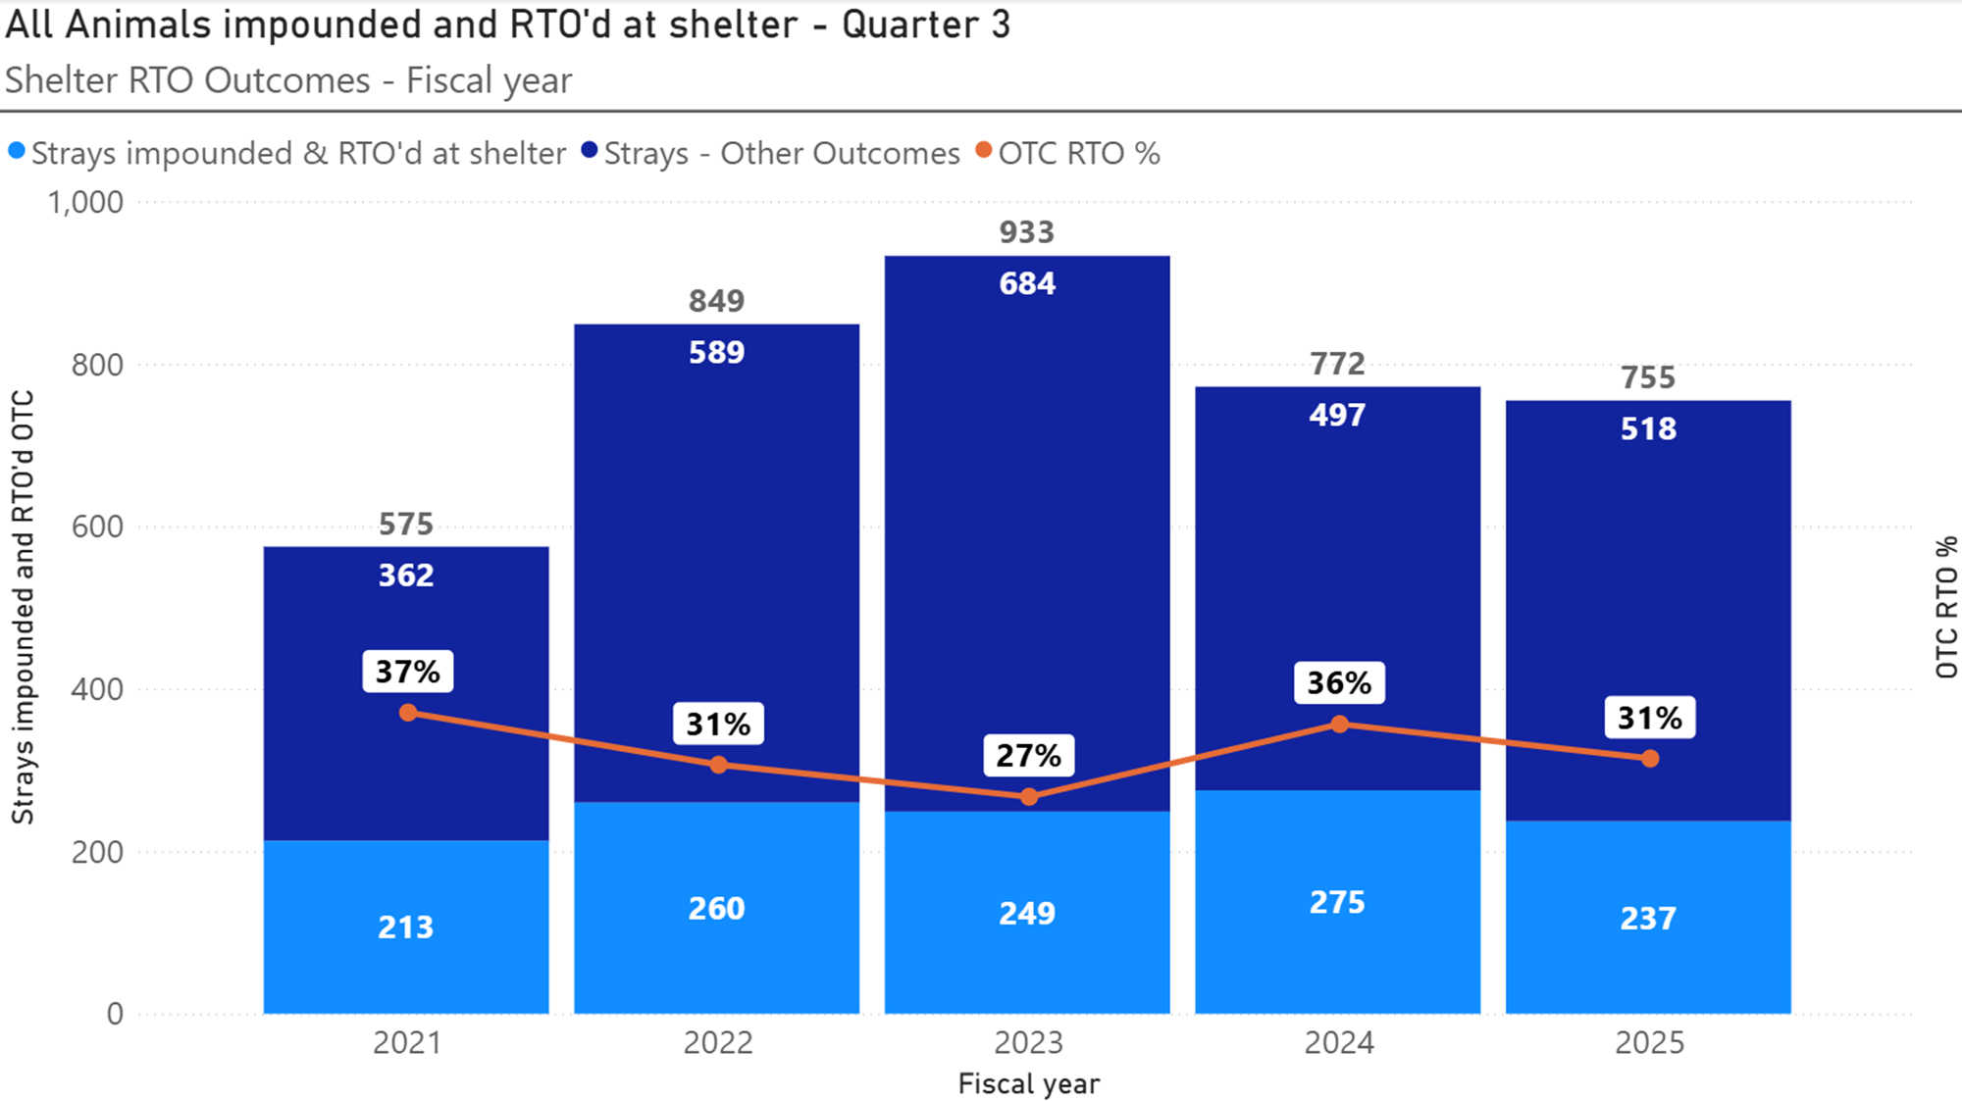
Animals Reunited in Shelter

Slide 8
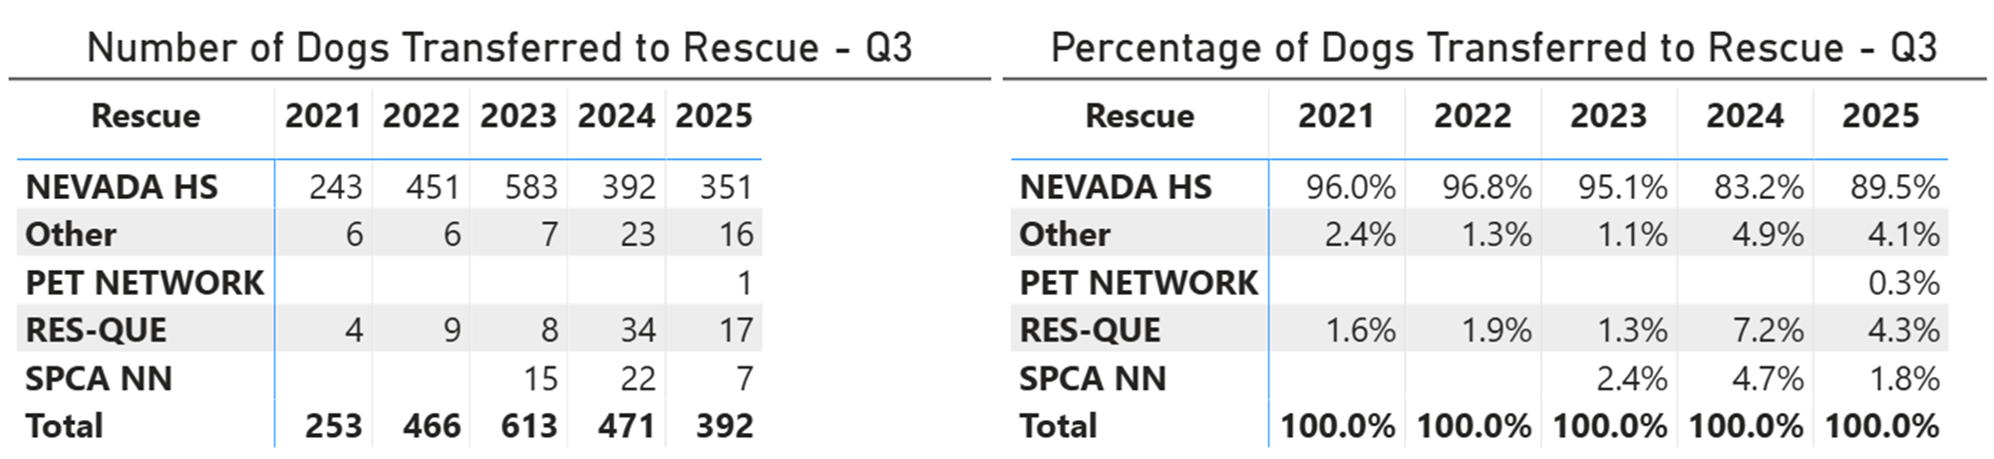
Dog Transfers to Rescue Partners

Slide 9
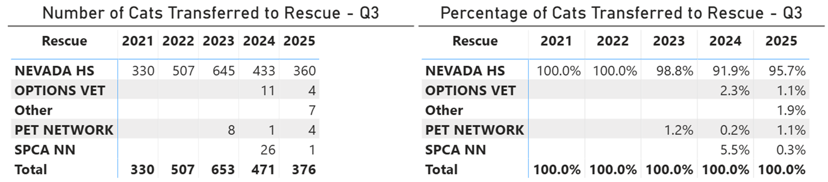
Cat Transfers to Rescue Partners

Slide 10
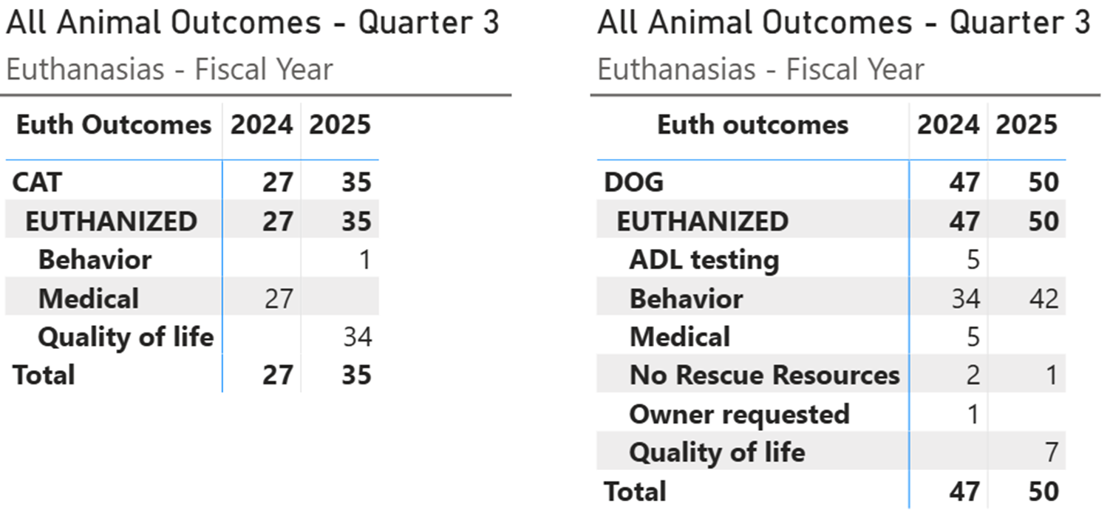
Euthanasia Reasons

Slide 11
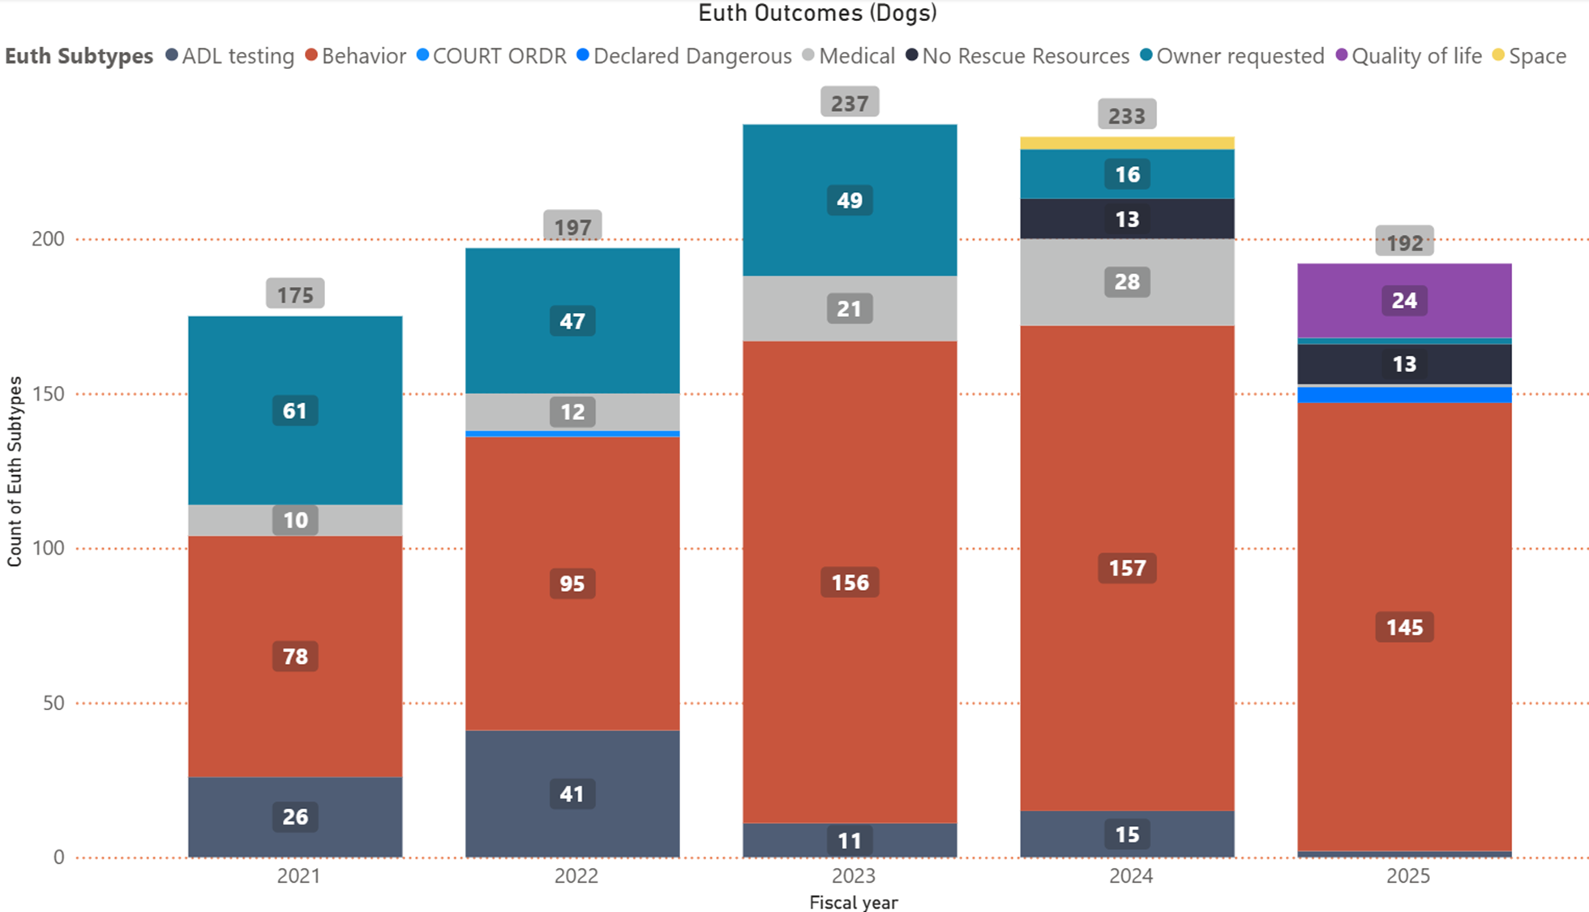
Fiscal Yearly Euthanasia Dogs

Slide 12
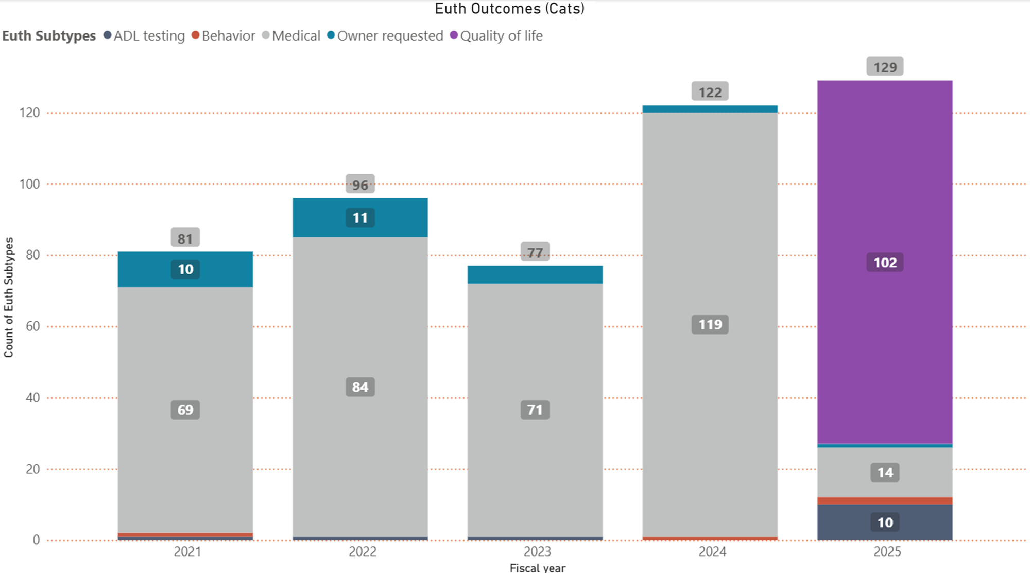
Fiscal Yearly Euthanasia Cats

Slide 13
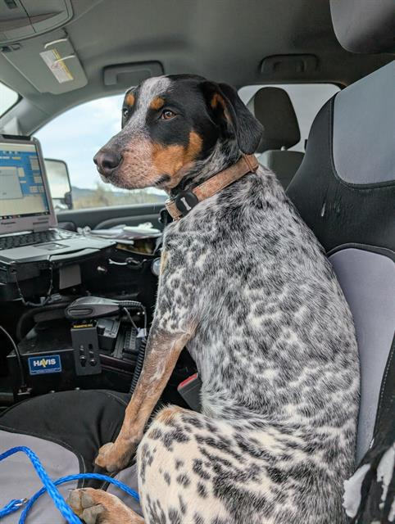
Field Services

Slide 14
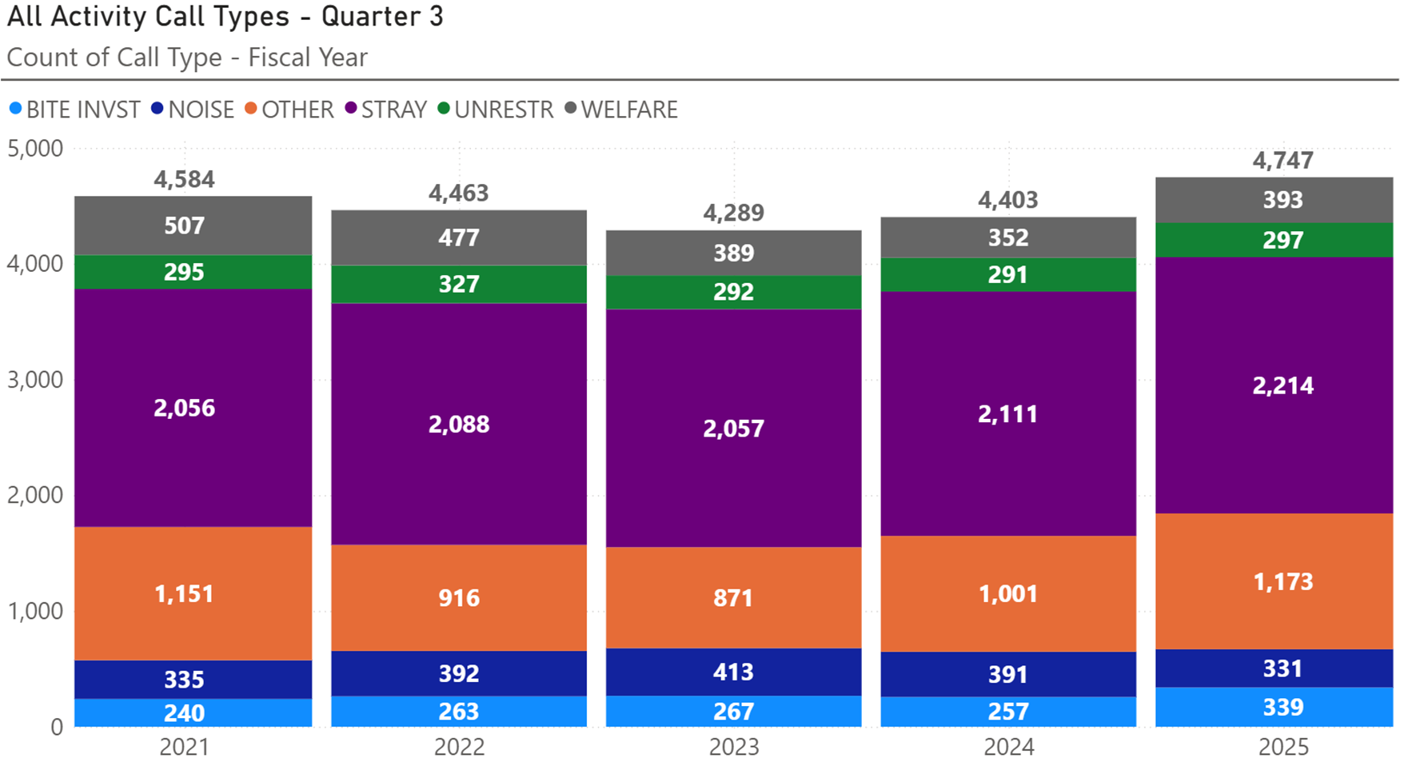
All Field Service Calls

Slide 15
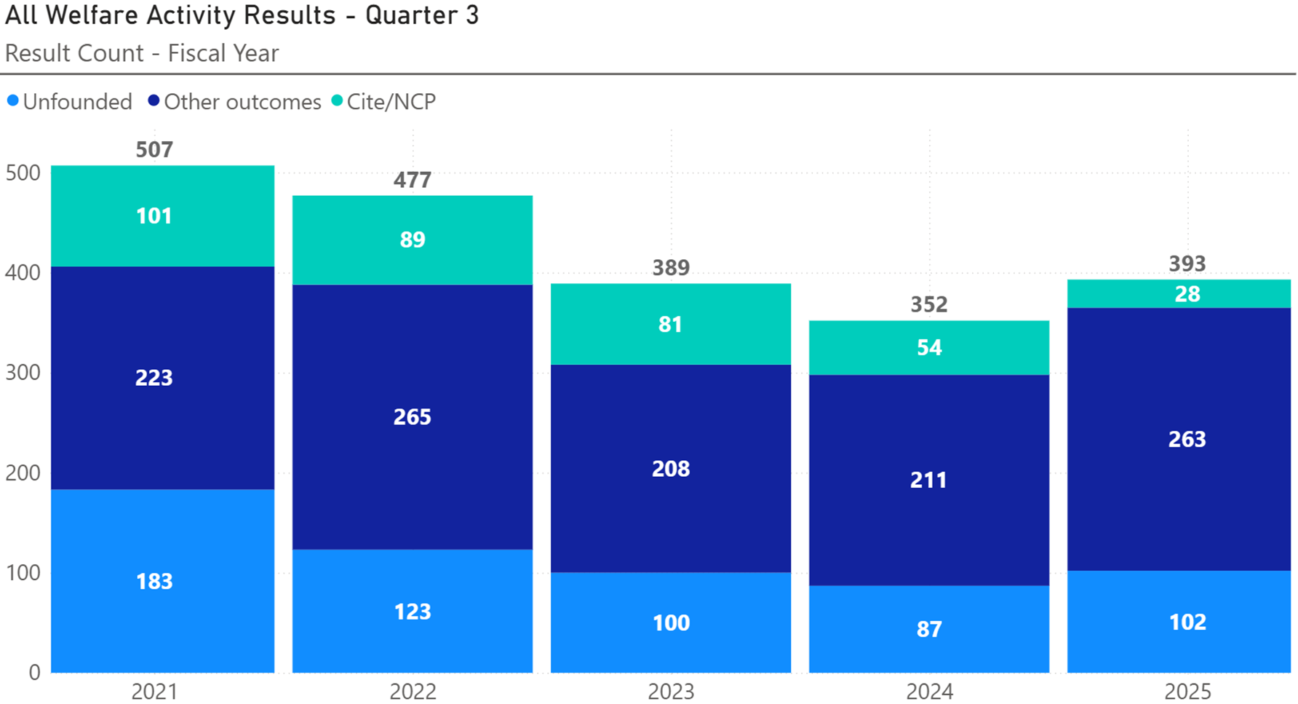
Welfare Related Calls

Slide 16
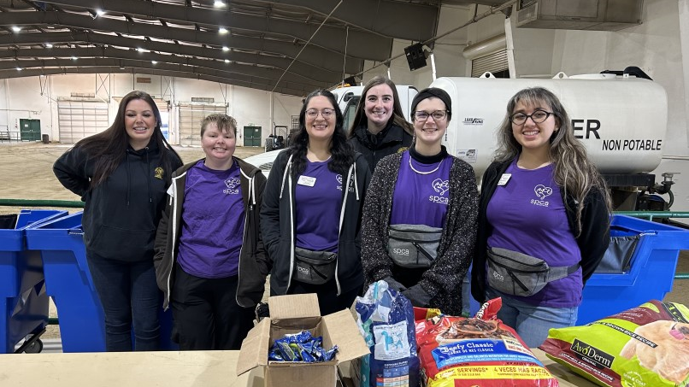
Outreach Programs

Slide 17





Vaccine Clinics & Pet Food Distribution
Q3 FY 24
Q3 FY 25
CARES Support
85
43
Pet food (Seniors served)
234
320
Pet food (Pets served)
517
523
Vaccines Given
1,765
553
Pets vaccinated
753
351

Slide 18
Event Details
Clinics
3
Vaccination clinics (3)
351 pets served
258 rabies vaccines administered
136 microchips implanted or registered
Other events
5
NV Energy Dog Safety presentation
Washoe County Leadership academy Tour of WCRAS
CERT Disaster Preparedness Presentation
Jordan’s Way fundraiser for Res-Que
Spay/Neuter Awareness Month
Pet food Distribution events
3
523 pets of seniors served (215 cats & 308 dogs)

Slide 19

Res-Que’s Karma Box Partnership
SPCA provides pet food donations to WCRAS
WCRAS re-bags large bags of pet food into 4lb and 5lb bags
WCRAS provides ~180lb (20 bags of cat food and 20 bags of dog food) of pet food each week to be distributed to the Karma boxes by Res-Que volunteers
Additional donated supplies are provided when available (emergency water packs, toys, treats etc.)
Webpage added to our site: http://washoeanimals.com/karma-box

Slide 20
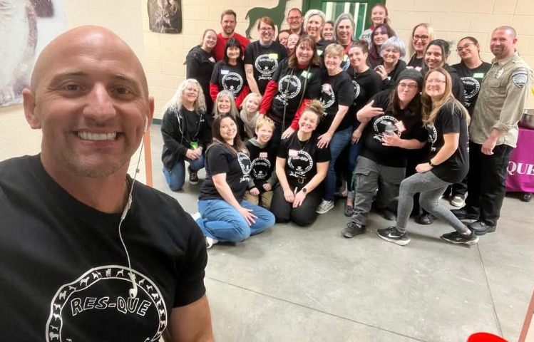
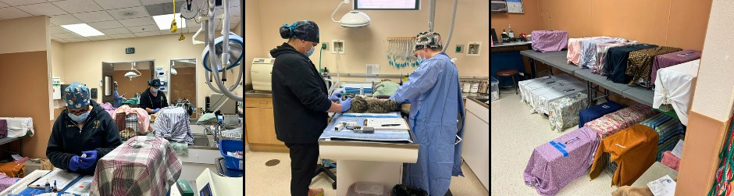
Events continued
Jordan’s way fundraiser for Res-Que
Nearly $11,000 raised in 3 hours
World Spay Day
Options Veterinary Care
SPCA of Northern Nevada
WCRAS
542 Spay/Neuters in February!

Slide 21
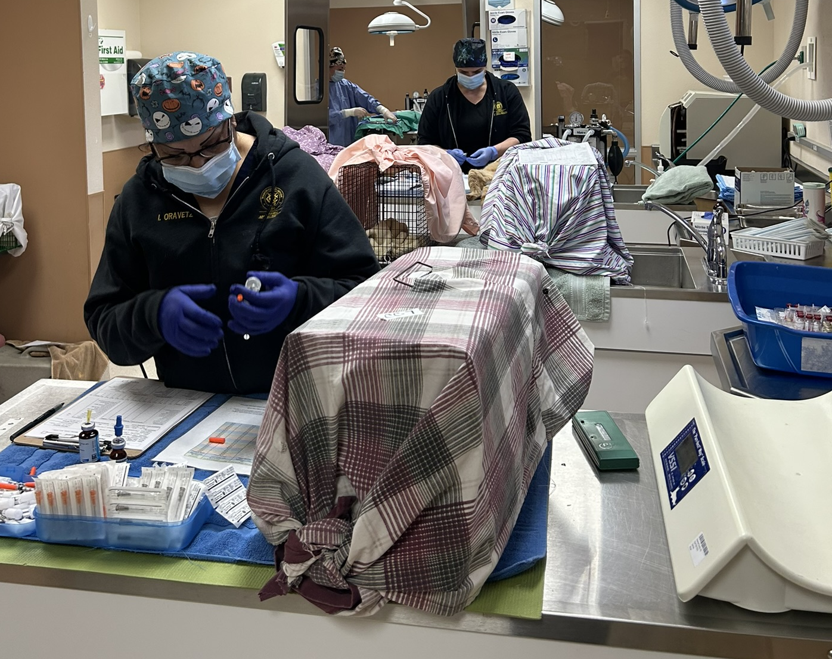
Medical Team

Slide 22
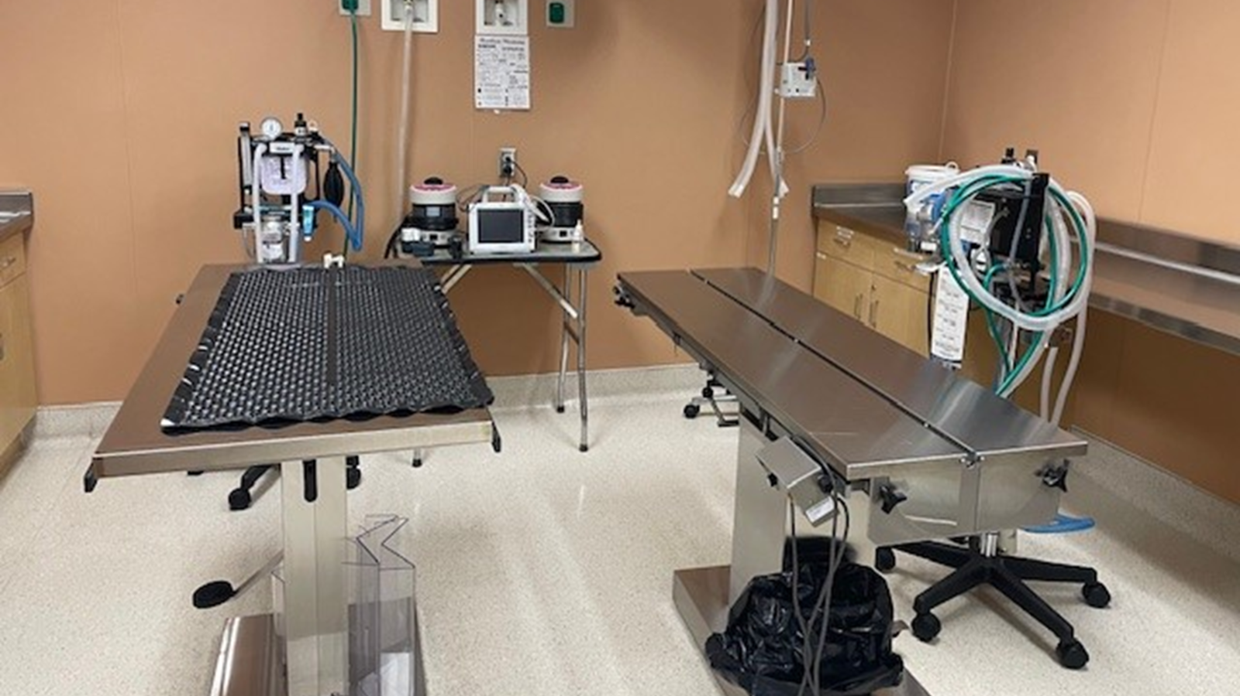



Medical Team Stats
TNR Surgeries
112
Return to Field Surgeries
6
Rescue Partner Surgeries
17
CARES vaccinations
38
Cruelty Cases
4
Necropsies
1

Slide 23
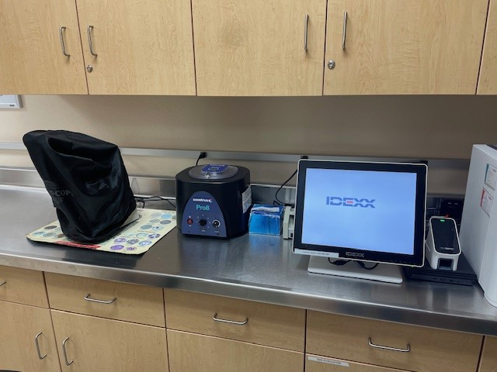
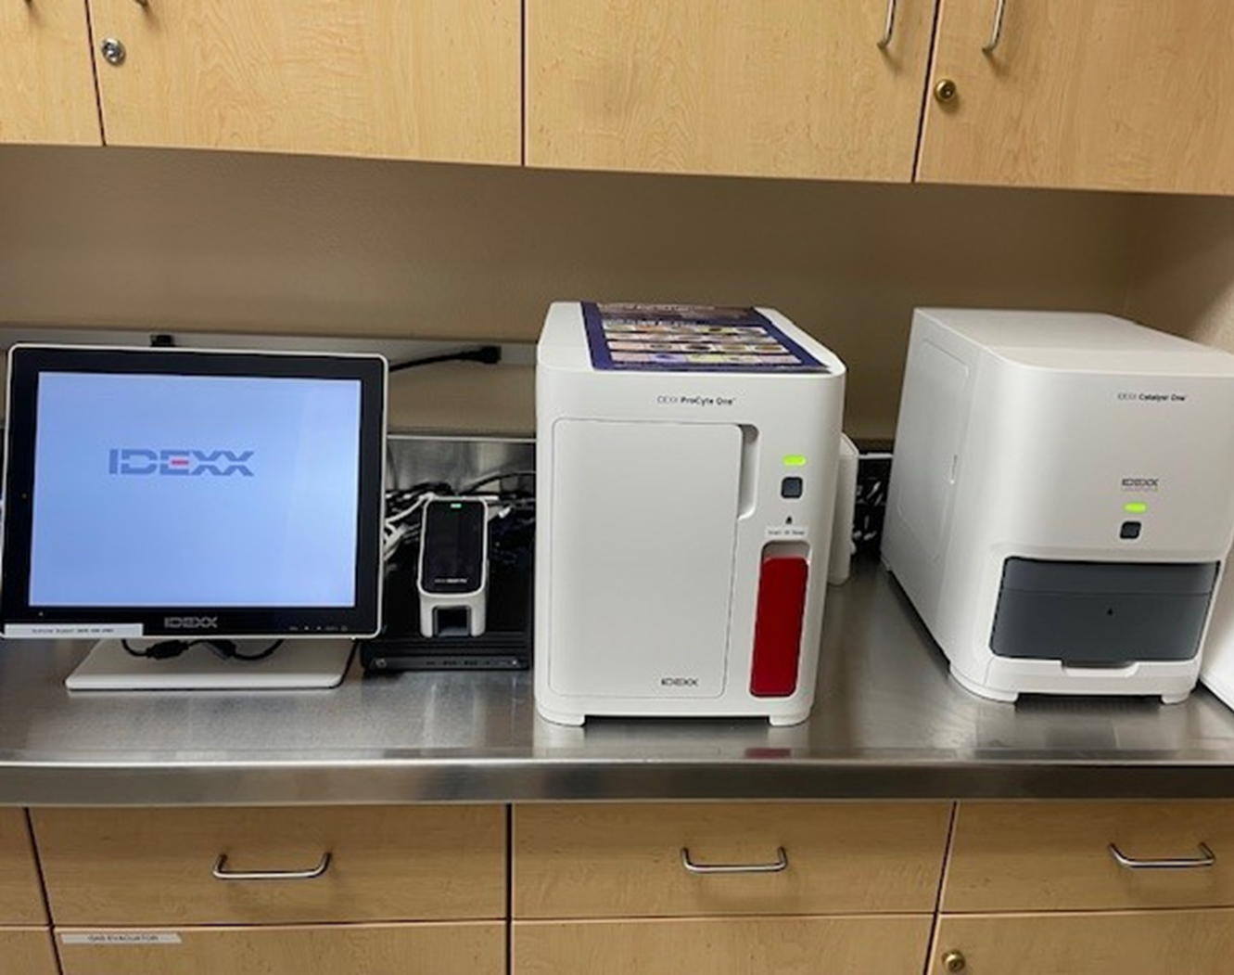
New Lab Equipment
Microscope
Centrifuge
Central computer
Chemistry Analyzer
Hematology Analyzer
Snap Test Analyzer

Slide 24
Thank You!

